Slide 1
Research AI agent
IBM HACKATHON PROJECT
Presented By:
Faculty name : Dr. Hafizur Rahman
College Name : Vel Tech Rangarajan Dr.Sagunthala R&D Institute of Science and Technology
Department : CSE

Slide 2
OUTLINE
Problem Statement
Technology used
Wow factor
End users
Result
Conclusion
Future Scope
IBM Certifications

Slide 3
Problem Statement
Academic and scientific researchers face some significant challenges-
In managing the vast and ever-growing volume of literature,
Extracting relevant information efficiently, and
Maintaining accurate citation records.
Manual processes for literature search, summarization, hypothesis generation, and drafting research documents are time-consuming and prone to errors, limiting productivity and innovation.
There is a critical need for an intelligent system that can-
Autonomously understand research questions,
Retrieve and synthesize relevant information,
Automate repetitive tasks such as citation management and data extraction, and
Assist in generating reports and drafting research papers.
Such a system would significantly enhance the efficiency, accuracy, and innovation potential of research activities in both academic and industrial settings.
Proposed Solution: An AI Research Agent that uses Natural Language Processing (NLP) to assist users in conducting efficient literature reviews, generating summaries, identifying research gaps, and recommending relevant papers, datasets, or collaborators.

Slide 4
Technology used
IBM Cloud Lite
Natural Language Processing (NLP)
IBM Granite Model

Slide 5
IBM cloud services used
IBM Cloud Watsonx AI Studio
IBM Cloud Watsonx AI Runtime
IBM Cloud Agent Lab
IBM Granite Foundation Model

Slide 6
Wow factors
The Research Agent revolutionizes the research process by combining advanced natural language understanding with autonomous literature exploration and intelligent data synthesis.
It transforms weeks of manual effort into minutes by seamlessly searching vast databases, summarizing complex papers, and managing citations with near-perfect accuracy.
Unique features:
Semantic search across research papers, journals, and datasets
Auto-summarization of selected papers
Citation and Reference analysis to trace influence
Recommendation of research papers based on a user’s current topic
Collaboration mapping: suggests potential co-authors or institutions based on similar research interests.

Slide 7
End users
Academic Researchers
Research Institutions and Universities
Industry R&D Teams
Educators
Research Scientist
Technical Writers and Science Communicators
Consultants and Industry Analysts
Healthcare and Medical Researchers
Students

Slide 8
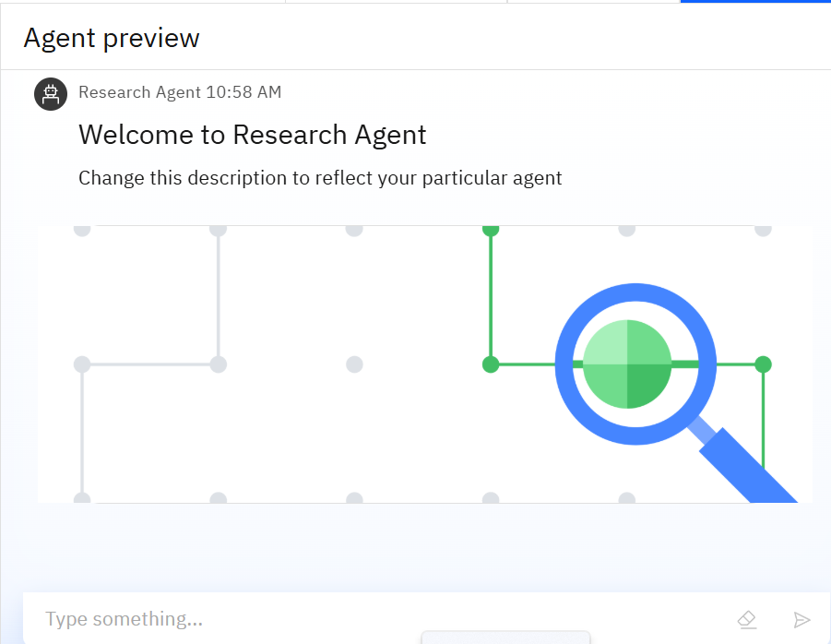
Results

Slide 9
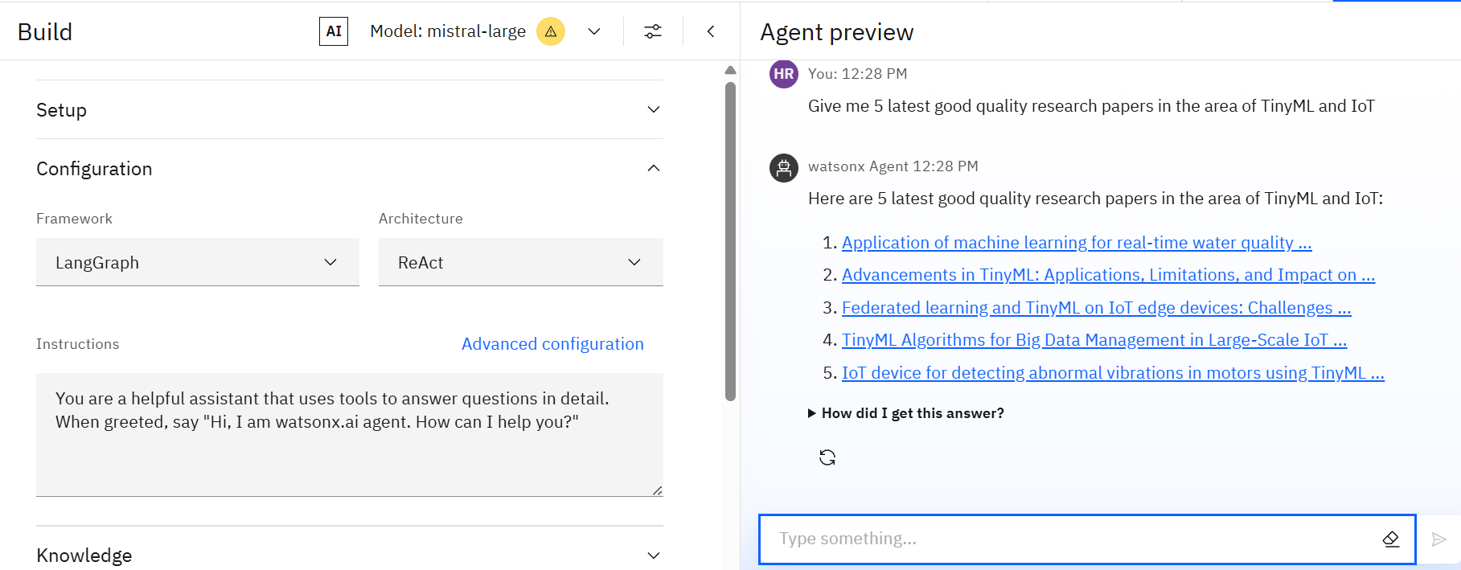
Results

Slide 10
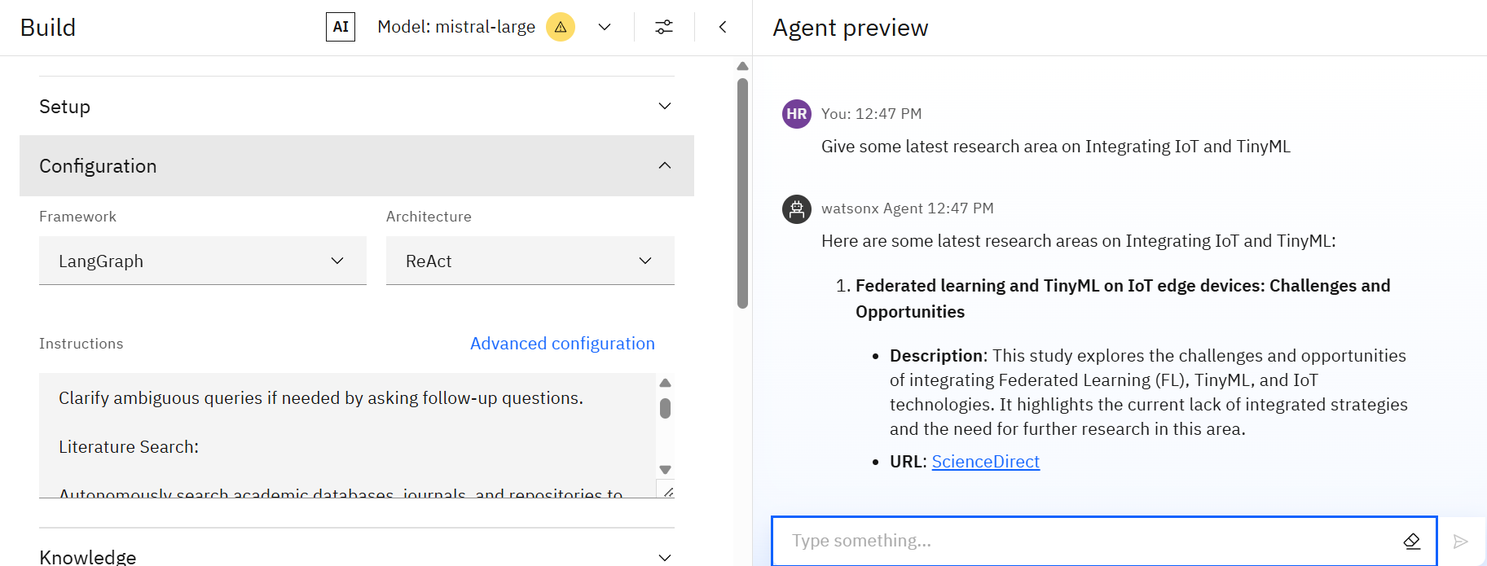
Results

Slide 11
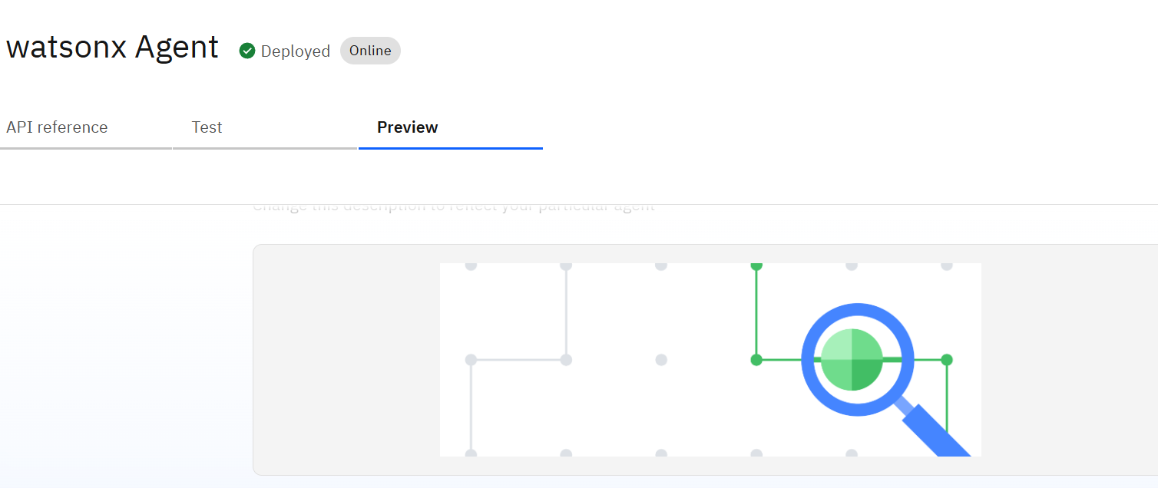
Results
Deployed AI Agent

Slide 12
Conclusion
This Research Agent represents a transformative advancement in academic and scientific research field by addressing some critical challenges.
The agent can generate reports, suggest hypotheses, and even draft sections of research papers.
It saves time by automating repetitive tasks like citation management and data extraction.
Research Agents enhance efficiency, accuracy, and innovation in both academic and industrial R&D field.

Slide 13
GitHub Link
URL for GitHub Repository: https://github.com/hafizur4557/IBM_Cloud.git

Slide 14
Future scope
Multimodal Research Understanding
Voice and Conversational Interfaces
Real-Time Collaboration Features
Research Gap and Novel Topic Identification
AI-Assisted Paper Drafting
Integration with Open Science Platforms

Slide 15
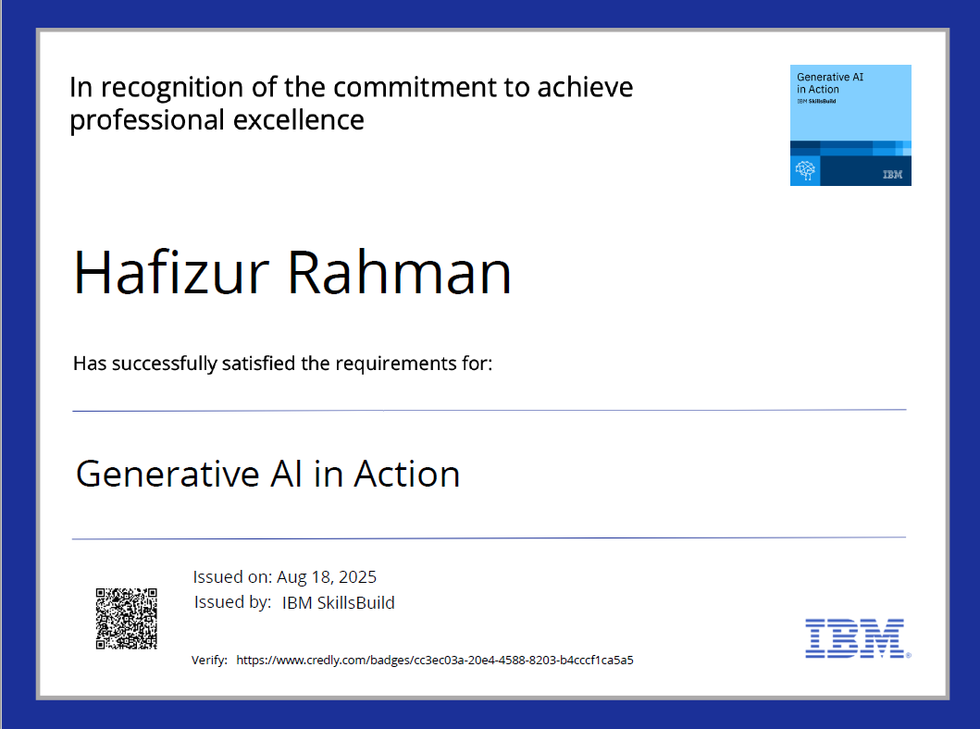
IBM Certifications

Slide 16
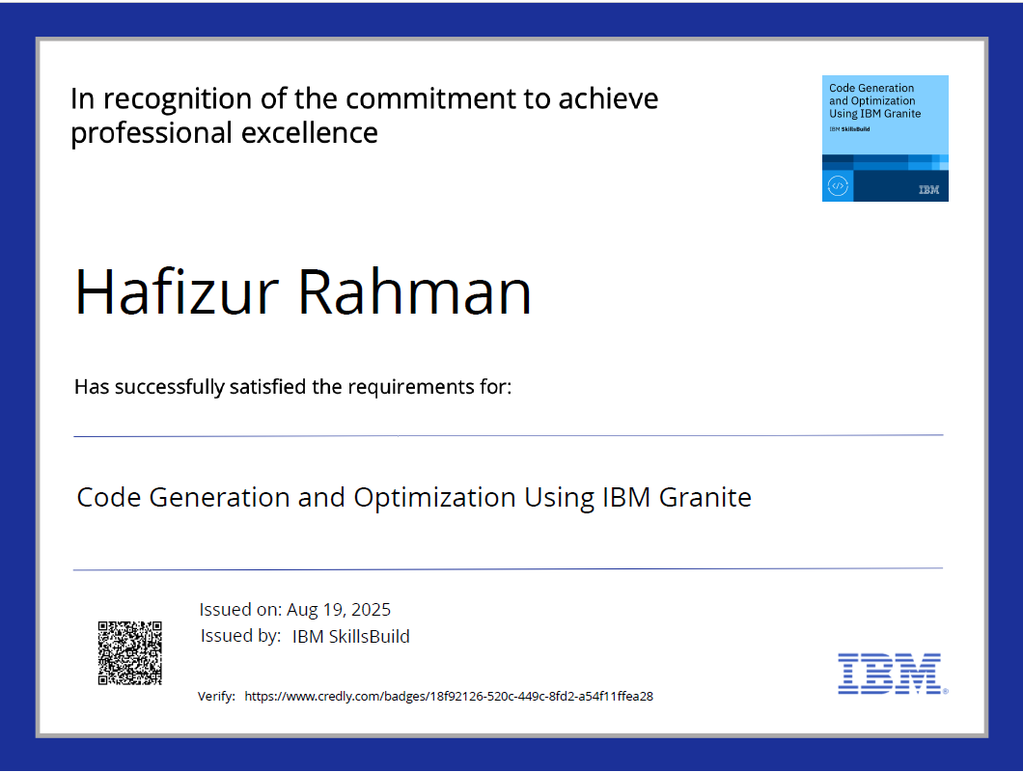
IBM Certifications

Slide 17
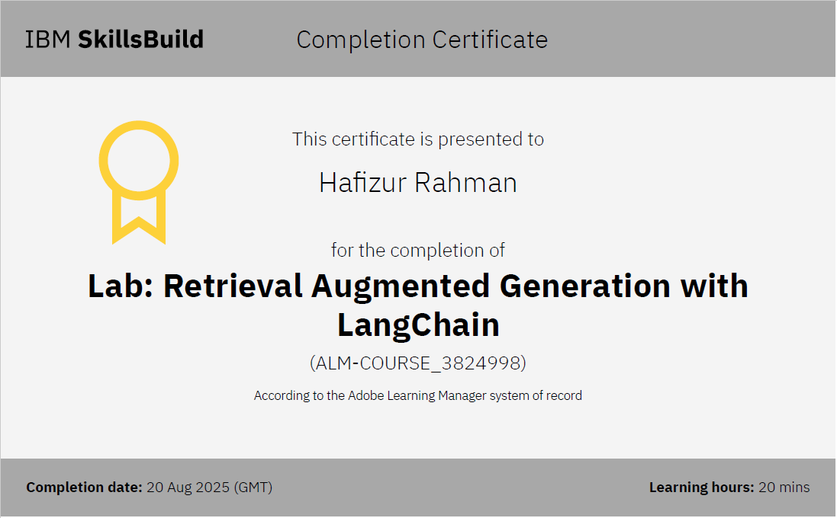
IBM Certifications

Slide 18
THANK YOU

